Slide 1
Customer Sentiment Analysis
British Airways (Skytrax Reviews)
By Sneha Murali

Slide 2
Objective
To evaluate the sentiment distribution of customer reviews.
To understand customer perceptions towards the product/service.

Slide 3
Methodology
Data Collection: Gathered reviews from Skytrax website
Sentiment Analysis: Utilized natural language processing (NLP) techniques to classify reviews into three categories: positive, negative, and neutral.
Visualization: Created a bar chart to visually represent the sentiments' distribution.

Slide 4
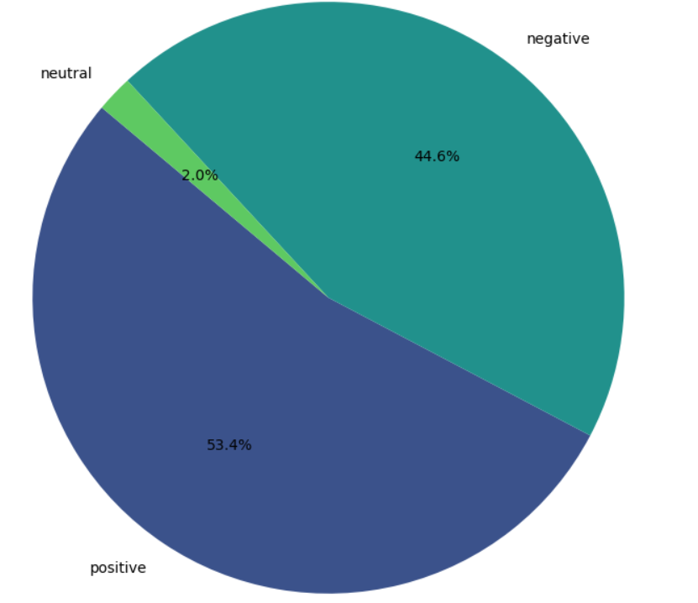
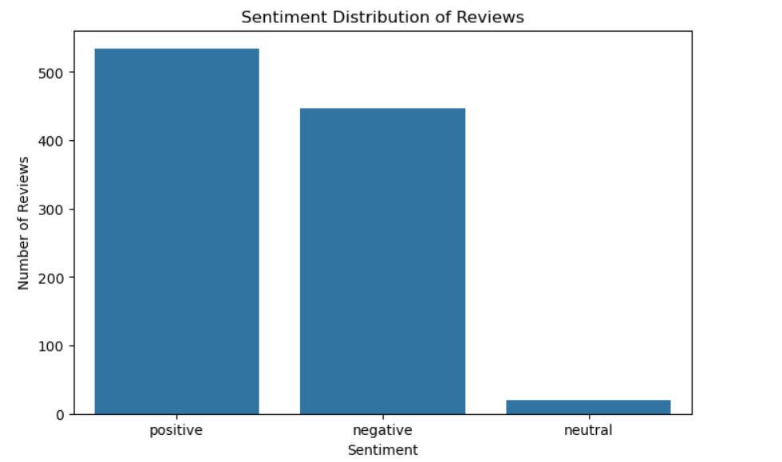
Key Insights
Sentiment Distribution: Positive Reviews: Approximately 500+ reviews, indicating strong customer satisfaction.
Negative Reviews: Approximately 400+ reviews, suggesting there are notable areas for improvement.
Neutral Reviews: A minimal number of neutral sentiments, indicating a lack of middle-ground opinions among customers.
Customer Satisfaction: The majority of reviews fall in the positive category, reflecting overall favorable opinions on the service.

Slide 5
Conclusion
Overall Sentiment: The analysis reveals a predominantly positive sentiment among customer reviews, although the number of negative reviews indicates opportunities for enhancements.
Actionable Recommendations: Focus on addressing the concerns raised in negative reviews to improve customer satisfaction further.
Continue to encourage positive feedback to maintain and augment brand reputation.

